Slide 1
CSE 440
Artificial Intelligence
Final Exam Review
Dr. Mohammad Mahmudul Alam
Department of Electrical & Computer Engineering (ECE)
North South University (NSU)

Slide 2
Syllabus
Lecture 08: Knowledge Representation & Reasoning
Lecture 09: Propositional Logic (PL)
Lecture 10: First-Order Logic (FOL)
Lecture 11: Probability & Bayes Net
Lecture 12: Machine Learning
Note: Please refer to the original slides for the final exam. This is a review class, and only a few selected topics will be covered — mainly those that may need extra clarification. However, the topics discussed in this class are not the only ones that will appear on the final exam. Make sure to study all topics from the original slides.

Slide 3
Propositional Logic
In a security system, the following conditions apply:
The light cannot be both on and the door open at the same time. If the motion sensor is not triggered, then the alarm will not sound. If the light is off and the door is not open, then the motion sensor will not trigger. If the alarm is not sounding, then either the backup lights must be on, or the security gate must be locked.
Propositional Symbols | KB
𝐴: The light is on. 𝐵: The door is open. 𝐶: The motion sensor is triggered. 𝐷: The alarm is sounding. 𝐸: The backup lights are on. 𝐹: The security gate is locked. | 1. ¬(A ⋀ B) 2. ¬C ⇒ ¬D 3. (¬A ⋀ ¬B) ⇒ ¬C 4. ¬D ⇒ E ⋁ F

Slide 4
English to FOL
Mary is not tall.
¬tall(Mary)
Every gardener likes the sun.
∀x gardener(x) ⇒ likes(x, Sun)
You can fool some of the people all the time.
∃x ∀t person(x) ⋀ time(t) ⇒ can-fool(x, t)
You can fool all the people some of the time.
∀x ∃t (person(x) ⇒ time(t) ⋀ can-fool(x, t))
∃x (person(x) ⇒ ∃t (time(t) ⋀ can-fool(x, t))

Slide 5
FOL to English
∀x has-a(x, Bachelors) ⇒ is-a(x, human)
Everyone who has a bachelors is human.
∃x has-a(x, Bachelors)
There exists some who has a bachelors.
∀x ∃y Loves(x, y)
Everybody loves somebody
∀x Man(x) ⇒ Mortal(x)
All men are mortal

Slide 6
Hoofers Club
Problem Statement: Tony, Shi-Kuo and Ellen belong to the Hoofers Club. Every member of the Hoofers Club is either a skier or a mountain climber or both. No mountain climber likes rain, and all skiers like snow. Ellen dislikes whatever Tony likes and likes whatever Tony dislikes. Tony likes rain and snow.
Query: Is there a member of the Hoofers Club who is a mountain climber but not a skier?
Let S(x) mean x is a skier, M(x) mean x is a mountain climber, and L(x,y) mean x likes y, where the domain of the first variable (x) is Hoofers Club members, and the domain of the second variable (y) is snow and rain.

Slide 7
Hoofers Club
We can now translate the above English sentences into the following FOL:
1. (∀x) S(x) ⋁ M(x) (Every member is either a skier or a mountain climber or both.)
2. ¬(∃x) M(x) ⋀ L(x, Rain) (No mountain climber likes rain.)
3. (∀x) S(x) ⇒ L(x, Snow) (All skiers like snow.)
4. (∀y) L(Ellen, y) ⇔ ¬L(Tony, y) (Ellen dislikes whatever Tony likes and likes whatever Tony dislikes)
5. L(Tony, Rain) (Tony likes rain.)
6. L(Tony, Snow) (Tony likes snow.)
Query: (∃x) M(x) ⋀ ¬S(x) (Is there a member of the Club who is a mountain climber but not a skier?)
Negation of the Query: ¬(∃x) M(x) ⋀ ¬S(x)

Slide 8
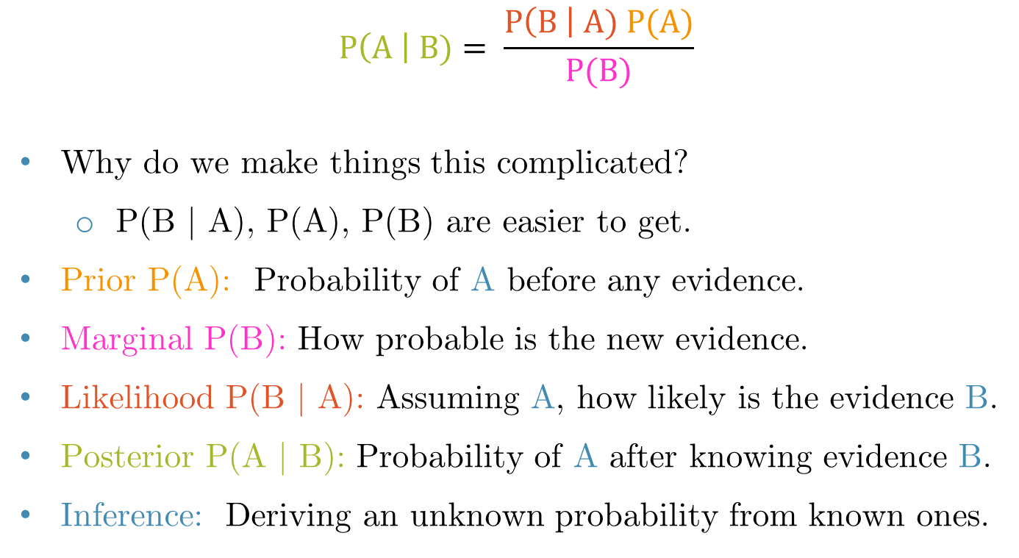
Bayes’ Rule
$$P\left(A \right| B)= \frac{P\left(B \right| A) P(A)}{P(B)}$$
Why do we make things this complicated?
P(B | A), P(A), P(B) are easier to get.
Prior P(A): Probability of A before any evidence.
Marginal P(B): How probable is the new evidence.
Likelihood P(B | A): Assuming A, how likely is the evidence B.
Posterior P(A | B): Probability of A after knowing evidence B.
Inference: Deriving an unknown probability from known ones.

Slide 9
Bayes’ Rule: Exercise
Problem: A doctor performs a test that has 99% reliability, i.e., 99% of people who are sick test positive, and 99% of people who are healthy test negative. The doctor estimates that 1% of the population is sick.
Query: A patient tests positive. What is the chance that the patient is sick?

Slide 10
Bayes’ Rule: Exercise
Problem: A doctor performs a test that has 99% reliability, i.e., 99% of people who are sick test positive, and 99% of people who are healthy test negative. The doctor estimates that 1% of the population is sick.
P(TP | S) = 0.99, P(¬TP | ¬S) = 0.99, P(S) = 0.01
P(S | TP) = P(TP | S) * P(S) / P(TP)
P(TP) = P(TP | S) P(S) + P(TP | ¬S) P(¬S)
= 0.99 * 0.01 + (1 – 0.99) [1 - P(¬TP | ¬S)] * (1 - 0.01)
= 0.0198
P(S | TP) = 0.99 * 0.01 / 0.0198 = 0.50 = 50%

Slide 11
Naïve Bayes Classifier
ID | Weather | Temperature | Humidity | Class (Play)
1 | Sunny | Hot | High | No
2 | Sunny | Hot | Normal | No
3 | Overcast | Hot | High | Yes
4 | Rainy | Mild | High | Yes
5 | Rainy | Cool | Normal | Yes
6 | Rainy | Cool | Normal | No
7 | Overcast | Cool | Normal | Yes
8 | Sunny | Mild | High | No
9 | Sunny | Cool | Normal | Yes
10 | Rainy | Mild | Normal | Yes
11 | Sunny | Mild | Normal | Yes
12 | Overcast | Mild | High | Yes
13 | Overcast | Hot | Normal | Yes
14 | Rainy | Mild | High | No

Slide 12
Naïve Bayes Classifier: Training
Compute Priors:
Count occurrences of each class: P(Yes) = 9/14, P(No) = 5/14
ID | Weather | Temperature | Humidity | Class (Play)
1 | Sunny | Hot | High | No
2 | Sunny | Hot | Normal | No
3 | Overcast | Hot | High | Yes
4 | Rainy | Mild | High | Yes
5 | Rainy | Cool | Normal | Yes
6 | Rainy | Cool | Normal | No
7 | Overcast | Cool | Normal | Yes
8 | Sunny | Mild | High | No
9 | Sunny | Cool | Normal | Yes
10 | Rainy | Mild | Normal | Yes
11 | Sunny | Mild | Normal | Yes
12 | Overcast | Mild | High | Yes
13 | Overcast | Hot | Normal | Yes
14 | Rainy | Mild | High | No

Slide 13
Naïve Bayes Classifier: Training
Compute Likelihood:
For each feature given a class, compute conditional probabilities:
Weather
P(Sunny | Yes) = 2/9, P(Sunny | No) = 3/5
P(Overcast | Yes) = 4/9, P(Overcast | No) = 0/9
P(Rainy | Yes) = 3/9, P(Rainy | No) = 2/5
Temperature:
P(Hot | Yes) = 2/9, P(Hot | No) = 2/5
P(Mild | yes) = 4/9, P(Mild | no) = 2/5
P(Cool | Yes) = 3/9, P(Cool | No) = 1/5
Humidity
P(High | Yes) = 3/9, P(High | No) = 3/5
P(Normal | Yes) = 6/9, P(Normal | No) = 2/5

Slide 14
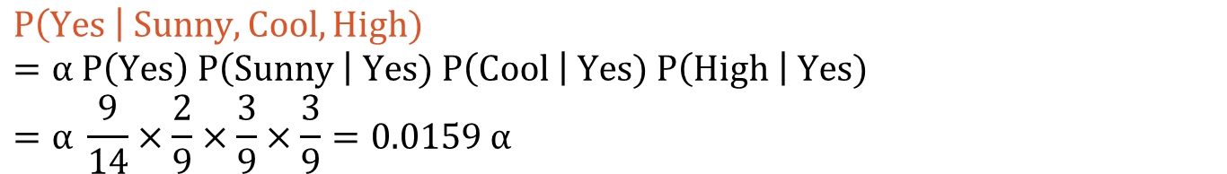
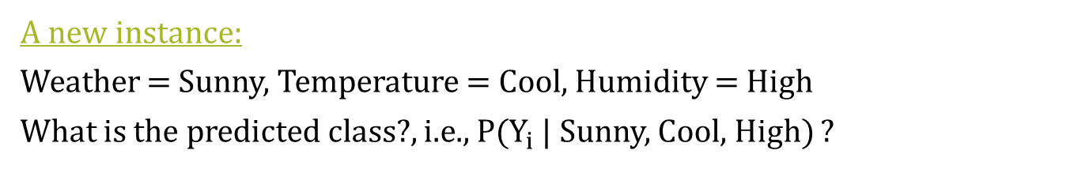
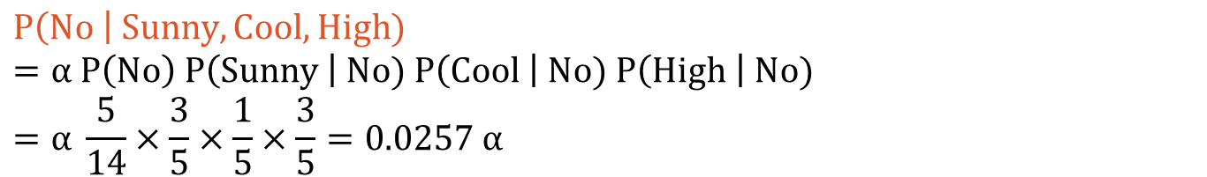
Naïve Bayes Classifier: Inference
A new instance:
Weather = Sunny, Temperature = Cool, Humidity = High
What is the predicted class?, i.e., P($Y_{i}$ | Sunny, Cool, High) ?
$$P\left(Yes \right| Sunny, Cool, High)=α P\left(Yes\right) P\left(Sunny \right| Yes) P\left(Cool \right| Yes) P\left(High \right| Yes) \\ =α \frac{9}{14}×\frac{2}{9}×\frac{3}{9}×\frac{3}{9}=0.0159 α$$
$$P\left(No \right| Sunny, Cool, High) \\ =α P\left(No\right) P\left(Sunny \right| No) P\left(Cool \right| No) P\left(High \right| No) \\ =α \frac{5}{14}×\frac{3}{5}×\frac{1}{5}×\frac{3}{5}=0.0257 α$$
$$Since, α is a positive constant, we can say P\left(No\right)> P\left(Yes\right),$$
$$Therefore, the classifier predicts \text{"}\text{No}\text{"}.$$

Slide 15
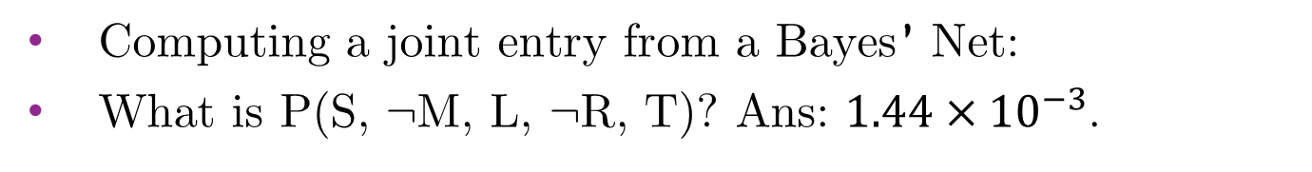
Bayesian Network (Bayes’ Net)
P(S) = 0.3
S
M
P(M) = 0.6
L
R
P(L|M,S) = 0.05
P(L|M,¬S) = 0.1
P(L|¬M,S) = 0.1
P(L|¬M, ¬S) = 0.2
P(R|M) = 0.3
P(R|¬M) = 0.6
T
P(T|L) = 0.3
P(T|¬L) = 0.8
Computing a joint entry from a Bayes’ Net:
What is P(S, ¬M, L, ¬R, T)? Ans: $1.44×{10}^{−3}$.

Slide 16
Bayes’ Net Inference
Instead of computing the joint, suppose we just want the probability for one variable.
We will explore two exact methods of computation:
Enumeration
Variable Elimination

Slide 17
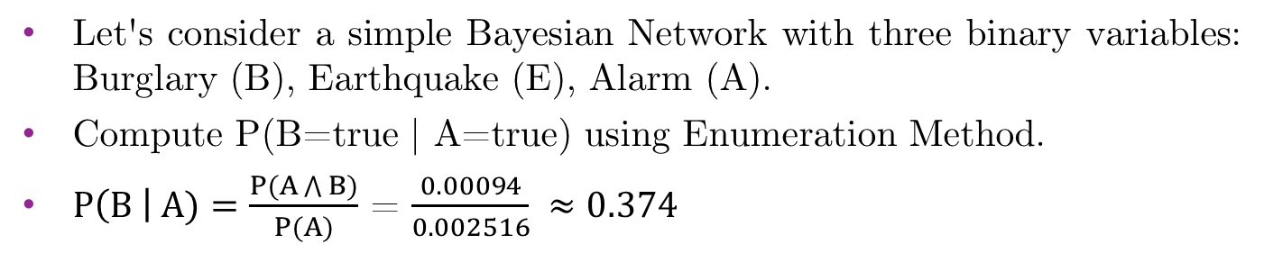
Enumeration
P(B) = 0.001
B
E
P(E) = 0.002
A
P(A|B,E) = 0.95
P(A|B,¬E) = 0.94
P(A|¬B,E) = 0.29
P(A|¬B,¬E) = 0.001
Let's consider a simple Bayesian Network with three binary variables: Burglary (B), Earthquake (E), Alarm (A).
Compute P(B=true | A=true) using Enumeration Method.
$P\left(B \right| A)=\frac{P(A\bigwedge{B})}{P(A)}$ = $\frac{0.00094}{0.002516} ≈0.374$

Slide 18
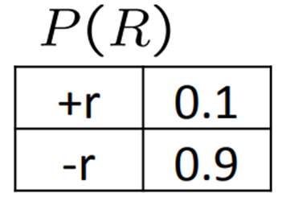
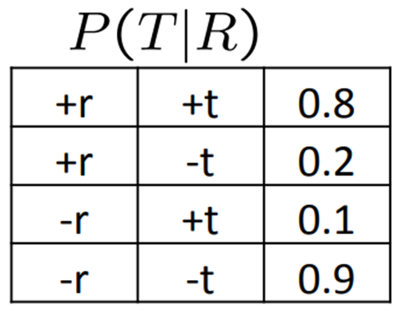
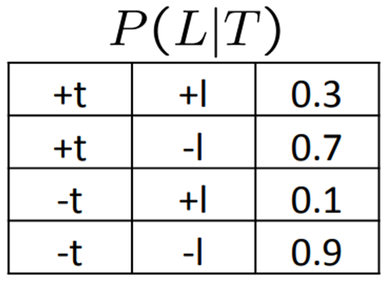
Variable Elimination
R
T
L
Random Variables:
R: Raining
T: Traffic
L: Late for class!
Compute P(L) using variable elimination method.
P(L) = <0.134, 0.866>

Slide 19
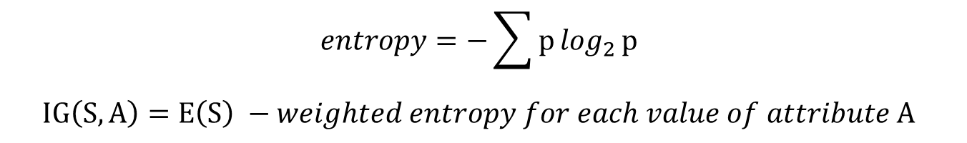
Decision Tree
ID | Weather | Temperature | Windy | Play
1 | Sunny | Hot | False | No
2 | Sunny | Hot | True | No
3 | Overcast | Hot | False | Yes
4 | Rain | Mild | False | Yes
5 | Rain | Cool | False | Yes
6 | Rain | Cool | True | No
7 | Overcast | Cool | True | Yes
8 | Sunny | Mild | False | No
9 | Sunny | Cool | False | Yes
10 | Rain | Mild | True | Yes
$$entropy=−\sum{p\log_{2}{p}}$$
$$IG\left(S, A\right)=E\left(S\right) −weighted entropy for each value of attribute A$$

Slide 20
What you should expect in exam
Ensure you are conceptually strong in all topics.
Practice translating between English and FOL.
Prepared for questions requiring proofs and explanations.
Expect lengthy mathematical questions (e.g., naïve bayes classifier, decision tree, etc.), so practice accordingly.
Mathematical content may include all topics covered in today’s session, and any material from the slides.

